Slide 1

Read Radar: Book Recommendation System
Notes:
Today we’ll be going over the following parts of the project.

Slide 2





Business Understanding
Data Understanding and Processing
Data Modelling
Results and Evaluation
Recommendations and Future Work
Notes:
Today we’ll be going over the following parts of the project.

Slide 3


Business Understanding
Data Understanding and Processing
Data Modelling
Results and Evaluation
Recommendations and Future Work

Slide 4


Business Understanding
Data Modelling
Results and Evaluation
Recommendations and Future Work
Data Understanding and Processing

Slide 5


Business Understanding
Data Understanding and Processing
Results and Evaluation
Recommendations and Future Work
Data Modelling

Slide 6
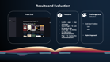

Business Understanding
Data Understanding and Processing
Data Modelling
Recommendations and Future Work
Results and Evaluation

Slide 7


Business Understanding
Data Understanding and Processing
Data Modelling
Results and Evaluation
Recommendations and Future Work

Slide 8




Business Understanding
The Problem
The Stakeholders
The Motivation
The Benefit
Building a Book Recommendation System
Allow Users to Like Books
Generate Recommendations using Collaborative filtering
Readers
Authors or Writers
Publishers
Personal Interest as an avid reader
Interested in implementing a collaborative filtering system
Potentially accurate recommendations for readers
Insights into reader preferences for writers
Book sales analysis
Notes:
Problem Identification:
Building a book recommendation system called ReadRadar.
Allows users to select liked books for recommendations.
Utilizes collaborative filtering for accurate book recommendations.
Stakeholders:
Writers, readers, publishers.
Motivation:
Personal interest as an avid reader.
Intrigued by the concept of collaborative filtering.
Potential Benefits:
Accurate recommendations for readers.
Insights for writers about reader preferences.
Insights for publishers about book sales.

Slide 9





Data Understanding and Preprocessing
The GoodReads Dataset:
For the sake of this project only the following datasets were utilized, and all this data has been scraped from GoodReads:
- goodreads_books.json.gz: Contains detailed information on about 2M books
- goodreads_book_genres_initial.json.gz: Extracted fuzzy book genres (genre tags are extracted from users' popular shelves by a simple keyword matching process)
- goodreads_interactions.csv: Complete user-book interactions
- book_id_map.csv:Contains user id and book id map
Notes:
All I had to do was load in the data and roll with it

Slide 10
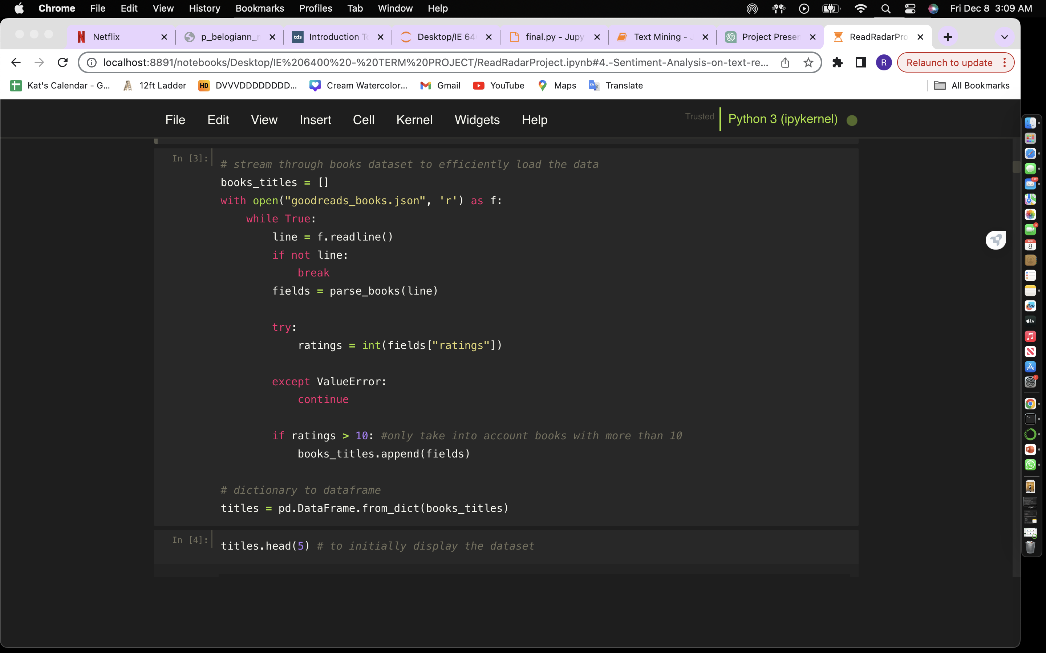
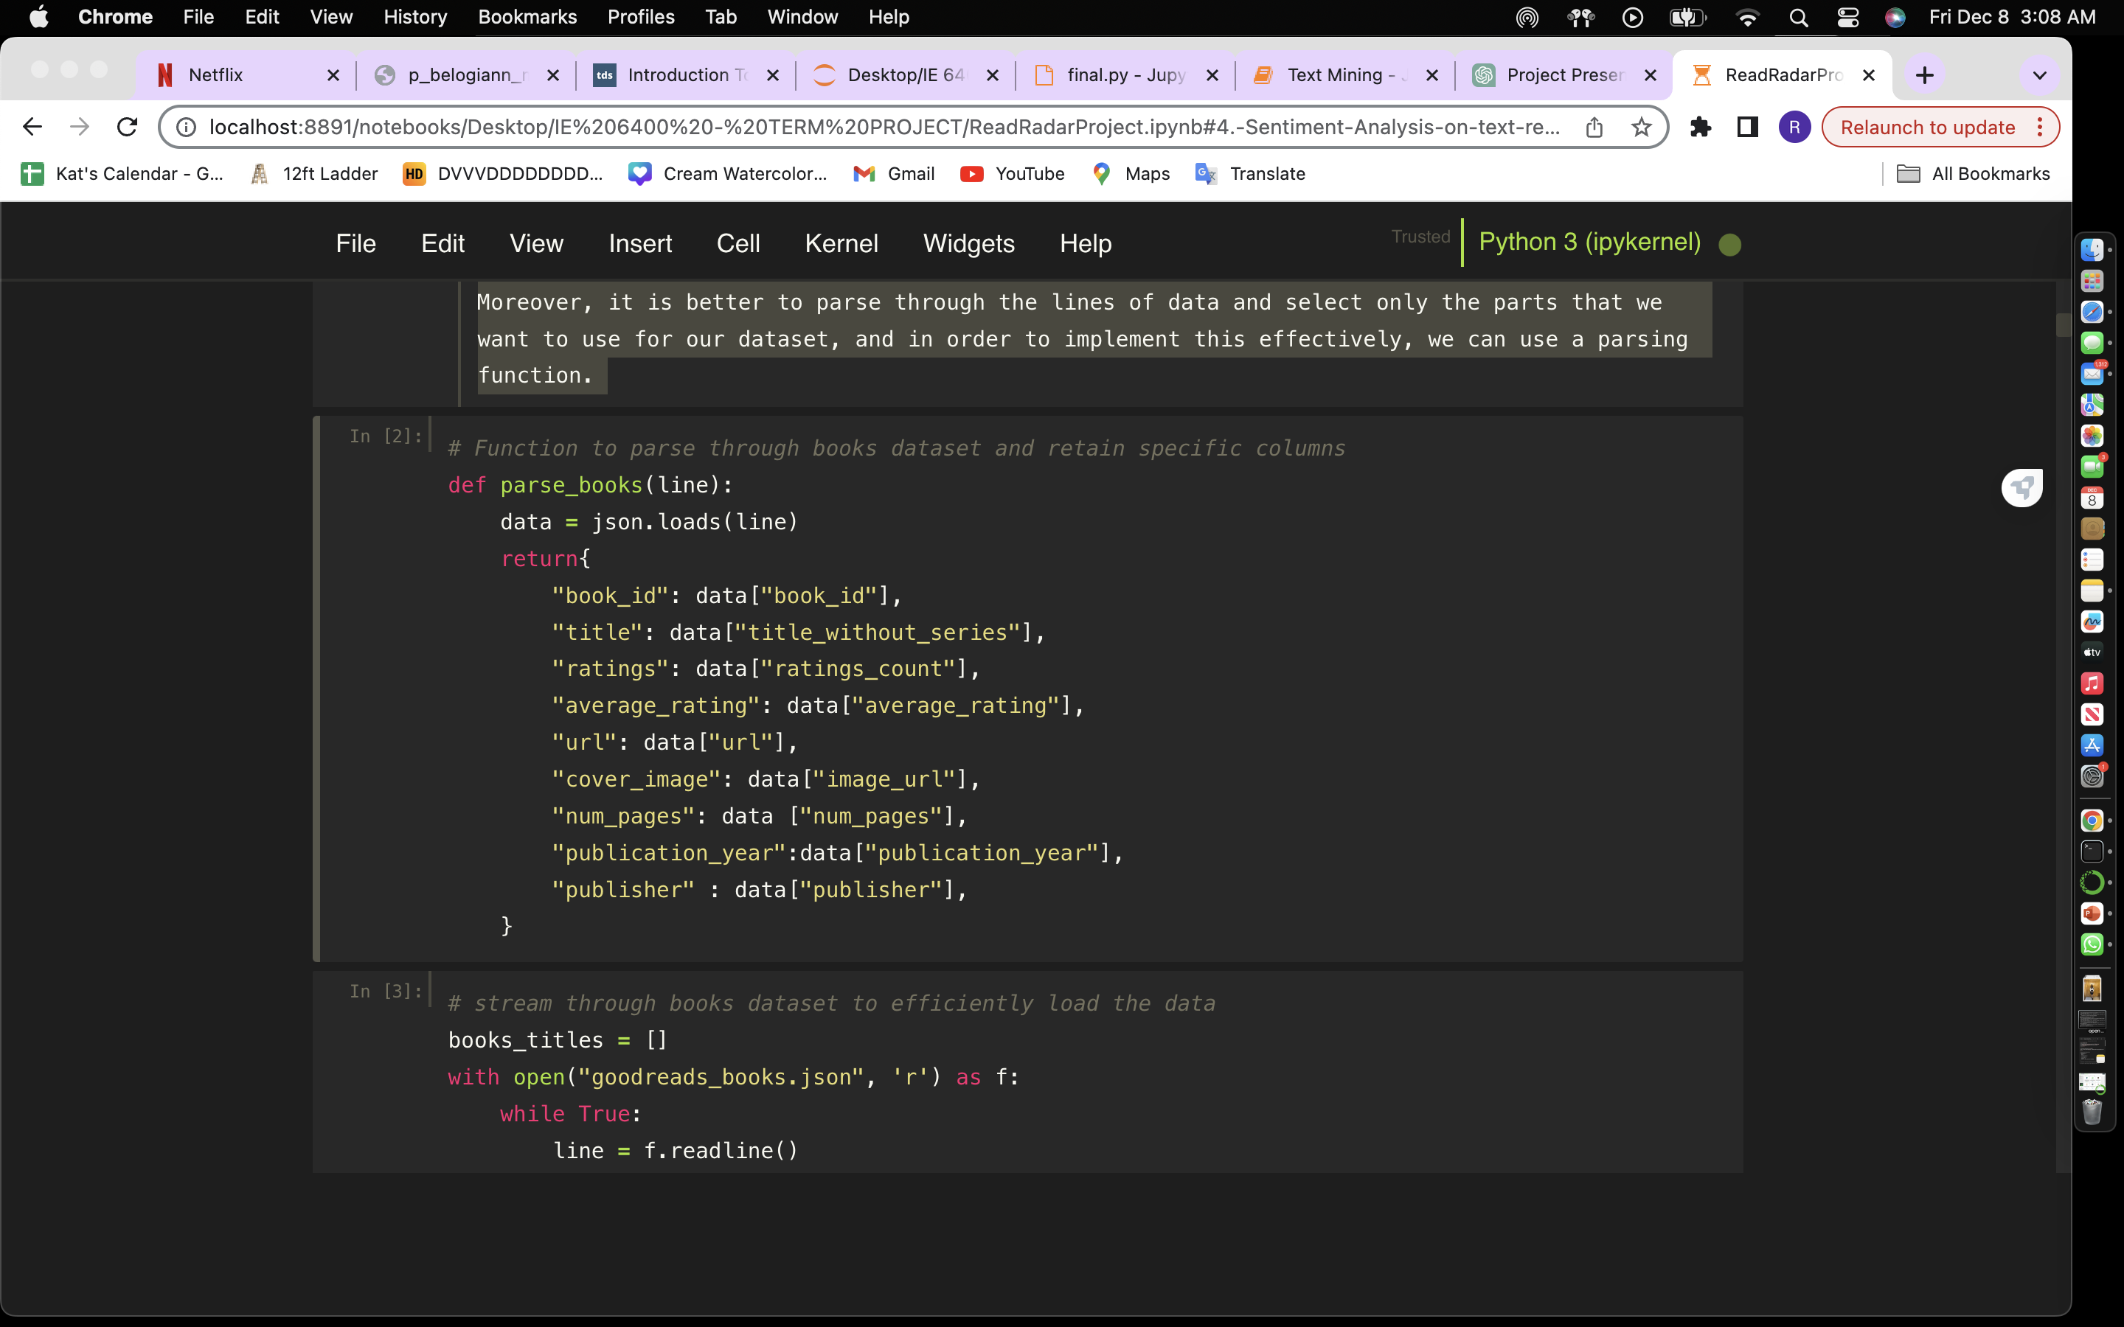
Data Understanding and Preprocessing
Steps Taken To Load The Data:
Mix of both json and csv files and we have very heavy data
Need Scalable and memory efficient approach to read
Introducing Streaming!
Notes:
In this case, we need to use a more scalable and memory efficient technique instead of loading the entire dataset, and that happens to be streaming the data line by line.
Moreover, it is better to parse through the lines of data and select only the parts that we want to use for our dataset, and in order to implement this effectively, we can use a parsing function.
Example for titles file

Slide 11
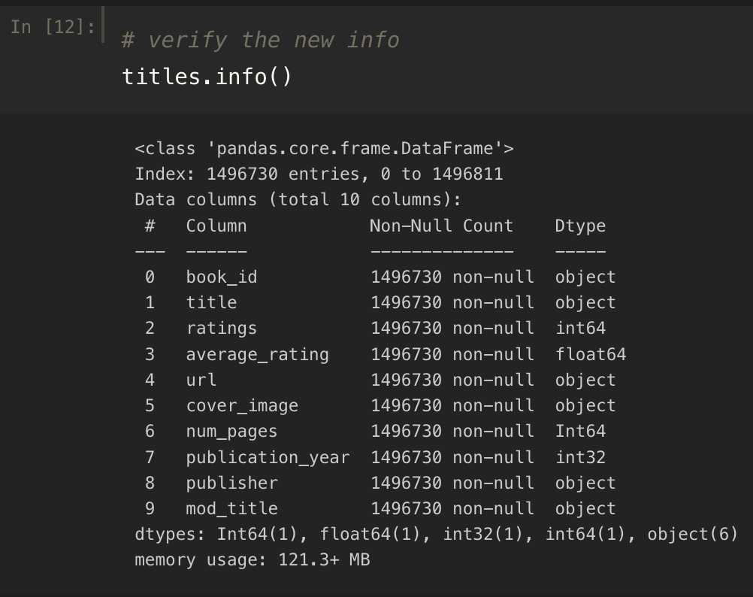
Data Understanding and Preprocessing
Data Preprocessing (titles df):
- Ensure 'ratings' column is numeric
- Crete a separate modified title for ease to search
- Ensure 'average_rating' is a float number
- Ensure 'num_pages' is an int number
- Ensure 'publication_year' is a date-time year
Fill in the hidden missing values appropriately
Use reviews df to add text_review_count feature

Slide 12
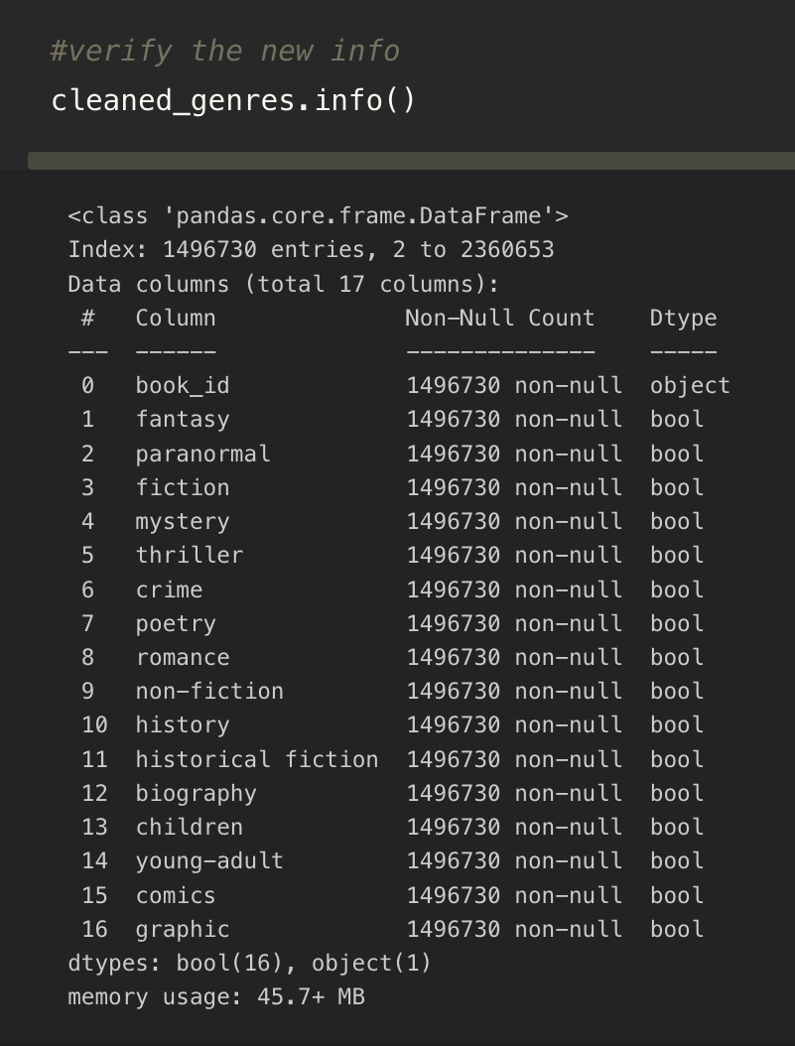
Data Understanding and Preprocessing
Data Preprocessing (genres df):
Extract the list of comma separated genres
Turn them into boolean features for each book_id
Merge with titles to retain relevant values only

Slide 13
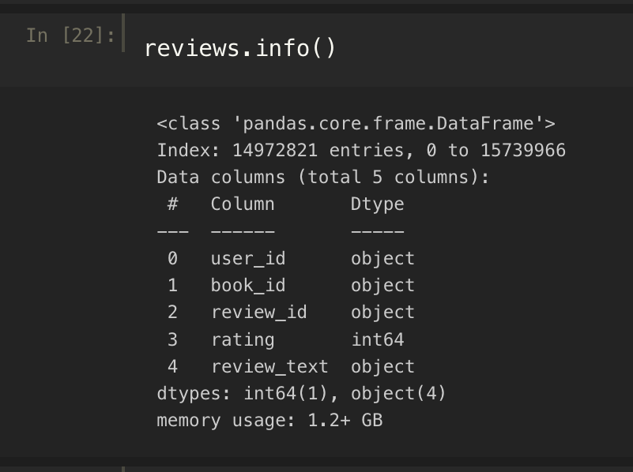
Data Understanding and Preprocessing
Data Preprocessing (genres df):
Need only the first 5 columns- user_id, book_id, review_id, rating and review_text
Merge with titles on book_id for relevant values
Create text_review count for titles df

Slide 14
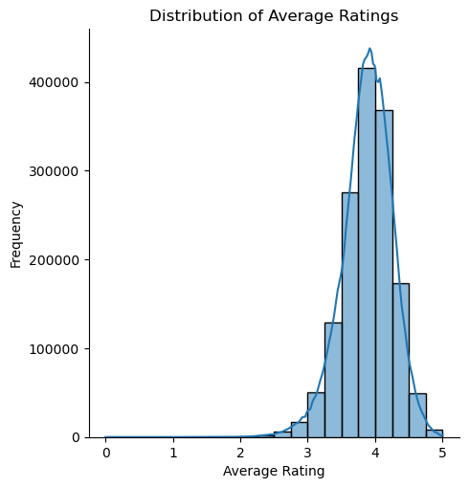
Data Understanding and Preprocessing
EDA 1: What is the distribution of average ratings for books?
Majority lies in 3.75 to 4.0 range
Notes:
The above kde distribution shows us that the majority of the books have an average rating in the 3.75 to 4 stars range. The distribution has a left or negative skew and a higher kurtosis or peak as well which may indicate that the majority of values for ratings are smaller and the distribution has outliers on the lower end of the scale.

Slide 15
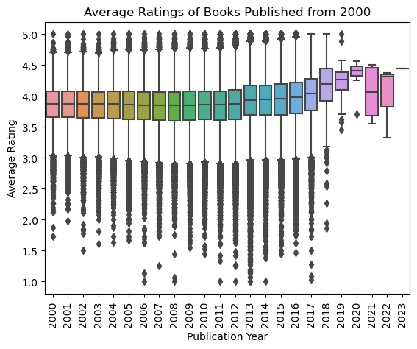
Data Understanding and Preprocessing
EDA 2: How are the average ratings of books distributed by publication year 2000 onwards?
The highest median value can be found in 2020, if we do not consider the sole book published in 2023.
We can also infer that most of the outliers have a rating below 3 stars.
Notes:
The above boxplot visualizations show us a distribution of the average ratings of the books published since the year 2000. We can see the summary statistics for each year, and it can be noted that the highest median value within this range can be found in the year 2020, if we do not take into account the sole book published in 2023. We can also infer that a majority of the outliers have a rating below 3 stars.

Slide 16
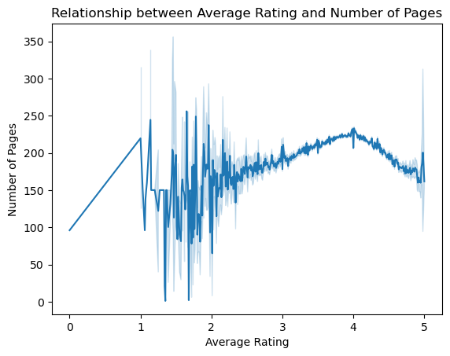
Data Understanding and Preprocessing
EDA 3: Is there a correlation between the number of pages and average ratings of books?
Volatility in lower ratings
Stabilization in mid to High ratings
Decrease in number of pages for higher ratings
Notes:
- Volatility in Lower Ratings: There is a high level of volatility in the number of pages for books with lower average ratings (from 0 to around 2). The error bars or confidence intervals are quite large in this section, indicating a wide variance in the number of pages for books with lower ratings.
- Stabilization in Mid to High Ratings: As the average rating increases (approximately from 2 to 4.5), the graph becomes more stable, and the confidence intervals/error bars become narrower. This suggests that there is less variance in the number of pages for books with higher ratings.
- Decrease in Number of Pages for Highest Ratings: There appears to be a slight decline in the number of pages as the rating approaches 5. This could indicate that books with the highest ratings do not necessarily have a high number of pages.

Slide 17
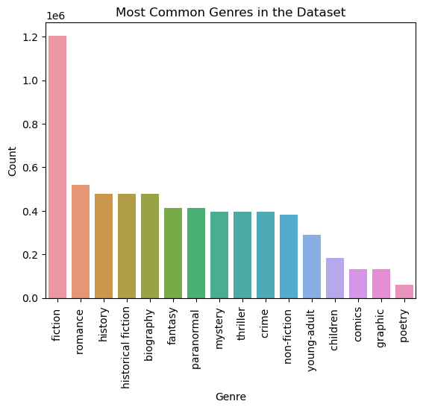
Data Understanding and Preprocessing
EDA 4: What are the most common genres in the dataset, and how do they correlate with user ratings?
Fiction genre has an exponentially greater frequency whereas poetry seems to be the least.
Notes:
The above barplot indicates that the fiction genre has an exponentially greater frequency within the books that we have in our dataset, whereas poetry seems to be the least. The romance, history , historical fiction and biography genres are around a similar range, on the higher end and then the lower end constitutes of graphic, comicd, children and young adult books.

Slide 18
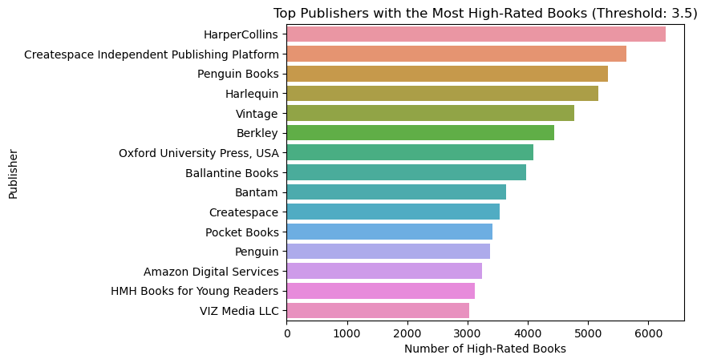
Data Understanding and Preprocessing
EDA 5: Which publishers have the most highly-rated books in the dataset?
HarperCollins has published the most high rated books with an average rating greater than 3.5, ranging to over 6000 books, whereas VIZ Media LLC seems to have published the least, about 3000 books
Notes:
The above horizontal barplot indicates that HarperCollins has published the most high rated books with an average rating equal to greater than 3.5, ranging to over 6000 books, whereas VIZ Media LLC seems to have published the least, about 3000 books.

Slide 19
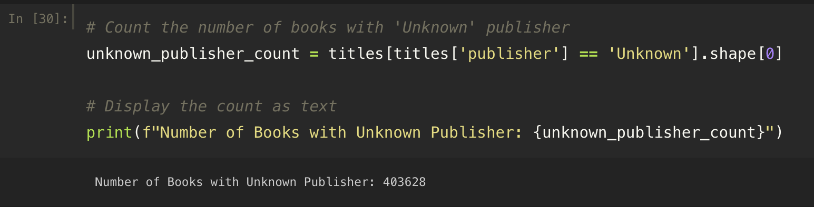
Data Understanding and Preprocessing
EDA 6: How many books have unknown publisher information?

Slide 20
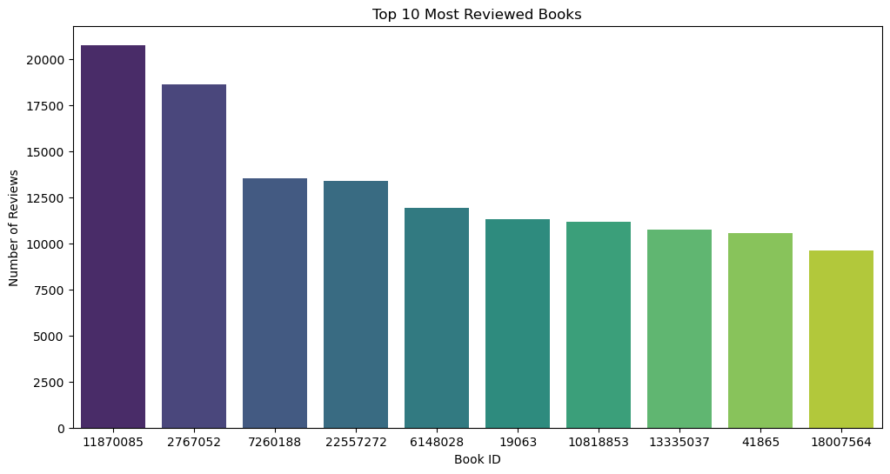
Data Understanding and Preprocessing
EDA 7: What are the top 10 highest reviewed books?
The Fault in Our Stars: 20756 reviews
The Hunger Games (The Hunger Games, #1): 18617 reviews
Mockingjay (The Hunger Games, #3): 13536 reviews
The Girl on the Train: 13402 reviews
Catching Fire (The Hunger Games, #2): 11904 reviews
The Book Thief: 11300 reviews
Fifty Shades of Grey (Fifty Shades, #1): 11184 reviews
Divergent (Divergent, #1): 10743 reviews
Twilight (Twilight, #1): 10535 reviews
The Martian: 9590 reviews
Notes:
- Volatility in Lower Ratings: There is a high level of volatility in the number of pages for books with lower average ratings (from 0 to around 2). The error bars or confidence intervals are quite large in this section, indicating a wide variance in the number of pages for books with lower ratings.
- Stabilization in Mid to High Ratings: As the average rating increases (approximately from 2 to 4.5), the graph becomes more stable, and the confidence intervals/error bars become narrower. This suggests that there is less variance in the number of pages for books with higher ratings.
- Decrease in Number of Pages for Highest Ratings: There appears to be a slight decline in the number of pages as the rating approaches 5. This could indicate that books with the highest ratings do not necessarily have a high number of pages.

Slide 21
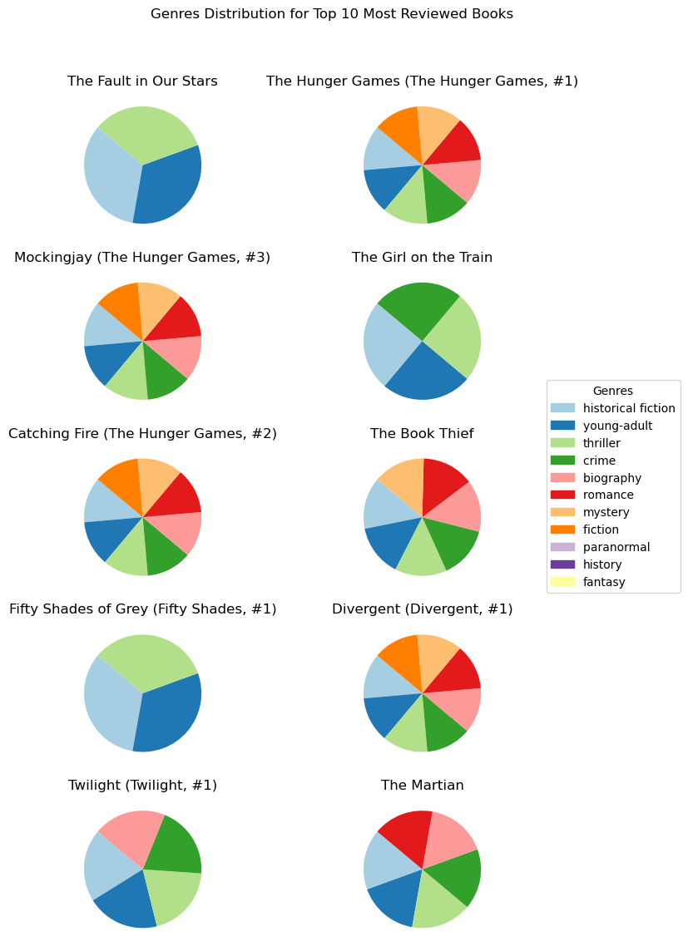
Data Understanding and Preprocessing
EDA 8: What is the genre distribution for the most highly reviewed books?
Notes:
- Volatility in Lower Ratings: There is a high level of volatility in the number of pages for books with lower average ratings (from 0 to around 2). The error bars or confidence intervals are quite large in this section, indicating a wide variance in the number of pages for books with lower ratings.
- Stabilization in Mid to High Ratings: As the average rating increases (approximately from 2 to 4.5), the graph becomes more stable, and the confidence intervals/error bars become narrower. This suggests that there is less variance in the number of pages for books with higher ratings.
- Decrease in Number of Pages for Highest Ratings: There appears to be a slight decline in the number of pages as the rating approaches 5. This could indicate that books with the highest ratings do not necessarily have a high number of pages.

Slide 22



Data Modelling
Logistic Regression
Text Analysis
Collaborative Filtering

Slide 23
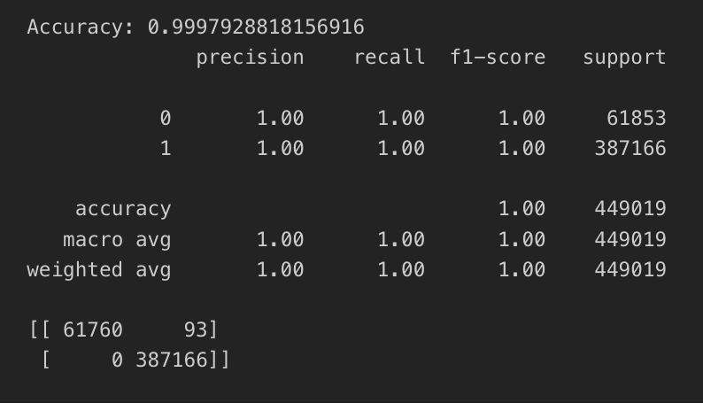
Data Modelling
Logistic Regression based on genres to determine if 3.5 is the average rating for books
- Accuracy
- Precision
- Confusion Matrix
- Summary Statistics
Logistic Regression
Notes:
Accuracy: The overall accuracy of the model is approximately 99.98%, which is very high. Accuracy is the ratio of correctly predicted instances to the total instances. In your case, it suggests that the model is making accurate predictions for both classes (0 and 1).
Precision: Precision is the ratio of correctly predicted positive observations to the total predicted positives. For class 0, precision is 1.00, and for class 1, precision is also 1.00. This indicates that when the model predicts a positive (1), it is almost always correct.
Recall (Sensitivity): Recall is the ratio of correctly predicted positive observations to the all observations in the actual class. Both for class 0 and class 1, recall is 1.00. This means the model is capturing all the instances of both classes in the dataset.
F1-Score: The F1-score is the weighted average of precision and recall. F1-score considers both false positives and false negatives. For both classes, the F1-score is 1.00, indicating a perfect balance between precision and recall.
Support: The number of actual occurrences of the class in the specified dataset. For class 0, there are 61,853 instances, and for class 1, there are 387,166 instances.
Confusion Matrix:
True Positive (TP): 387,166 instances were correctly predicted as class 1.
True Negative (TN): 61,760 instances were correctly predicted as class 0.
False Positive (FP): 93 instances were incorrectly predicted as class 1 when they were actually class 0.
False Negative (FN): 0 instances were incorrectly predicted as class 0 when they were actually class 1.

Slide 24
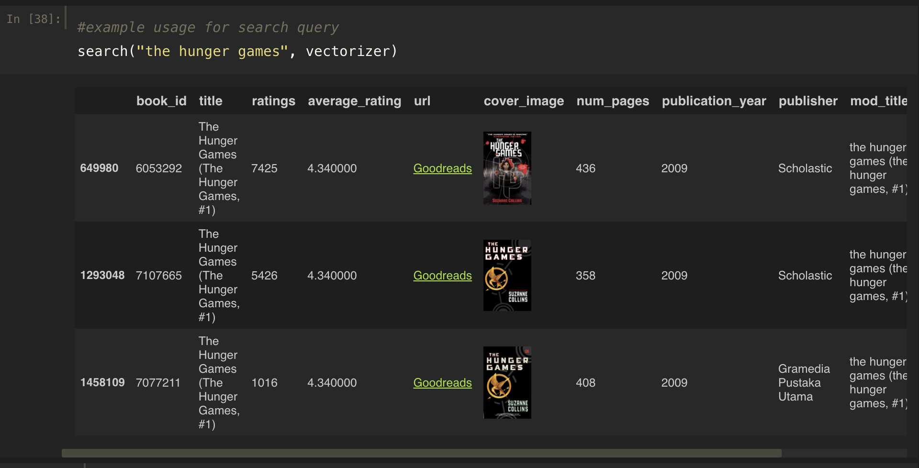
Data Modelling
Text Analysis using TF-IDF matrix, generating similarity score and creating a search functionality to select liked book list:
- Similarity Score
Text Analysis
Notes:
Term Frequency (TF): This is about how often a word appears in a search query. If a word is used frequently in a query, its term frequency is higher.
Inverse Document Frequency (IDF): This is about how unique or important a word is across multiple search queries. If a word is rare but appears in several different queries, its inverse document frequency is lower.
Now, combine these two:
If a word appears a lot in a specific query (high TF), and it's not very common across all queries (high IDF), then it's likely to be an important word for that particular query.
If a word is common across all queries (low IDF), it won't contribute much to distinguishing one query from another.

Slide 25
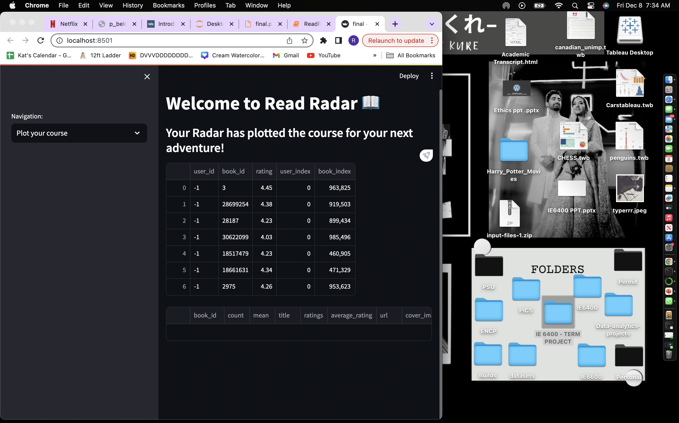
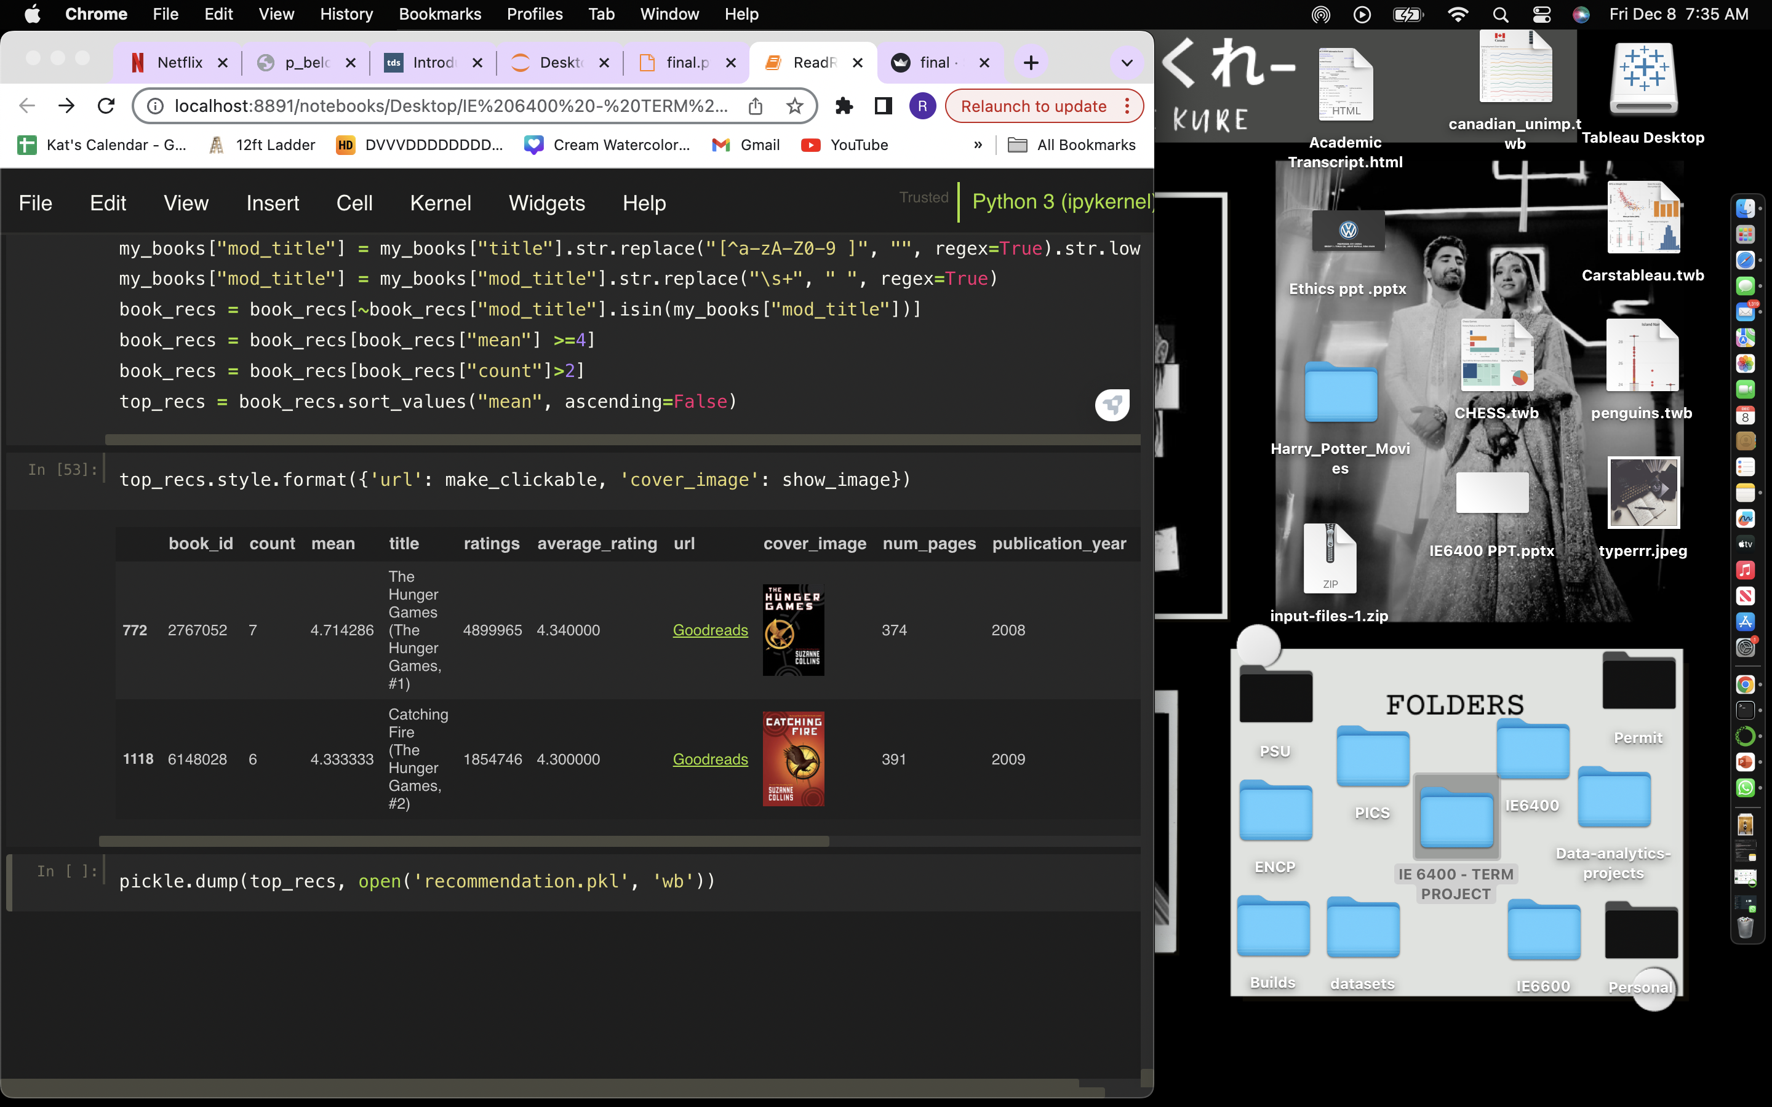
Data Modelling
Collaborative filtering using the similar users liked list and similar ratings to generate recommendations:
- Cosine Similarity Score
- Domain Knowledge
Collaborative Filtering
Notes:
Understanding Your Preferences:
The system looks at what you've liked, watched, or interacted with before. This could be movies, songs, books, or any other items.
Finding Similar Users or Items:
It then tries to find other users who have similar tastes or items that are similar to the ones you've liked. This is done by comparing your preferences with those of other users in the system.
Making Recommendations:
Based on what it learns about your preferences and similarities with others, the system suggests new items that you might enjoy. These could be movies you haven't watched, songs you haven't heard, or products you might be interested in.
Personalizing Suggestions:
The more you interact with the system (like rating, watching, or purchasing), the better it becomes at understanding your unique preferences. Over time, the recommendations become more personalized and accurate.
Different Recommendation Approaches:
Recommendation systems can use various techniques. One common approach is collaborative filtering, where the system relies on the preferences of a group of users to make suggestions. Another approach is content-based filtering, where the system recommends items based on the features of the items themselves and your past preferences.

Slide 26


Results and Evaluation
Front End
Features
Challenge and Solution
Landing page – top 100 books
Search Page – To look for books to like
Liked Page – To display the liked books
Recommendations Page – To display the recommendations
Cold Start Problem
User
Item
Hybrid Approach
Notes:
User Cold Start:
Description: Occurs when a new user joins the system, and there is little to no information about their preferences or behavior.
Challenge: Since collaborative filtering relies on user-item interactions, it's challenging to find similar users or make accurate recommendations without sufficient data about the new user.
Item Cold Start:
Description: Occurs when a new item is added to the system, and there is little to no user interaction data for that item.
Challenge: Without user interactions, it's difficult to identify users with similar preferences and provide accurate recommendations for the new item.

Slide 27



Recommendations and Future Work
Implement Author and publisher specific features
Feedback Loop Implementation
Collaboration with Publishers
Notes:
5. Continuous Model Refinement:
Recommendation:
Establish a process for continuous model refinement and optimization.
Strategy:
Regularly update the recommendation system with new data to adapt to evolving user preferences and reading trends.
6. Feedback Loop Implementation:
Recommendation:
Establish a feedback loop to gather user feedback on recommended books.
Purpose:
Use feedback to further refine and enhance the recommendation algorithms, ensuring a user-centric approach.
7. Collaboration with Publishers:
Recommendation:
Collaborate with publishers to enrich the dataset with additional metadata.
Advantages:
Improve the quality of recommendations by incorporating richer information about books, genres, and author details.
8. User Education on Rating System:
Recommendation:
Provide educational materials to users on the meaning and impact of their ratings.
Objective:
Improve the quality of user ratings, leading to more accurate predictions and personalized recommendations.

Slide 28
Any Questions?
Notes:
5. Continuous Model Refinement:
Recommendation:
Establish a process for continuous model refinement and optimization.
Strategy:
Regularly update the recommendation system with new data to adapt to evolving user preferences and reading trends.
6. Feedback Loop Implementation:
Recommendation:
Establish a feedback loop to gather user feedback on recommended books.
Purpose:
Use feedback to further refine and enhance the recommendation algorithms, ensuring a user-centric approach.
7. Collaboration with Publishers:
Recommendation:
Collaborate with publishers to enrich the dataset with additional metadata.
Advantages:
Improve the quality of recommendations by incorporating richer information about books, genres, and author details.
8. User Education on Rating System:
Recommendation:
Provide educational materials to users on the meaning and impact of their ratings.
Objective:
Improve the quality of user ratings, leading to more accurate predictions and personalized recommendations.

